Slide 1

Detection and Prevention of Distributed Denial of Service (DDoS) Attacks Using Machine Learning Techniques
Under the guidance of
Dr.S.MURUGAN
by
GUDISE VEERA VIKAS ( Reg.No - 40110408)
GANJI CHAKRESH ( Reg.No – 40110369 )

Slide 2
Presentation Outline
Abstract
Introduction
Work Done in Phase 1
Problem statement
Literature Survey
Interface from literature survey
Existing sytems
Goals
Objectives
Flow chart
System Architecture Diagrams
Project module description
Methodology
Result and Disscusion
Conclusion
Future enhancement
References
Conference certificate.

Slide 3
ABSTRACT
Detection and Prevention of Distributed Denial of Service (DDoS) Attacks is a critical component in various industries to protect against the unauthorized dissemination of sensitive information.
This process involves the identification of potential threats, such as data leaks or unauthorized sharing, and implementing measures to mitigate them. This can include the use of advanced technology, such as data loss prevention systems, to monitor and control the flow of data within an organization.
Additionally, employee training and awareness programs are essential in promoting a culture of security and ensuring compliance with distribution policies and procedures. Ultimately, the detection and prevention of distribution is an ongoing effort that requires a combination of technology, processes, and people to safeguard sensitive information.

Slide 4
Introduction
Detection and Prevention of Distributed Denial of Service (DDoS) Attacks is a critical aspect of maintaining the integrity and security of any system or network. By implementing robust detection mechanisms, organizations can identify and respond to potential threats and unauthorized access attempts in real-time.
This includes deploying technologies such as intrusion detection systems, firewalls, and network monitoring tools to actively monitor and analyze network traffic. Additionally, organizations should also focus on proactive measures such as implementing access controls, strong authentication mechanisms, and regular security audits to prevent potential distribution of sensitive data or malicious software.
By prioritizing detection and prevention, organizations can minimize the impact of security incidents and protect their data and network infrastructure from unauthorized access and distribution.

Slide 5
Work Done in Phase 1
Project Ideation
Literature Survey
Algorithms Research
Backend Module Started

Slide 6
PROBLEM STATEMENT
The problem of detection and prevention of distribution encompasses the challenges faced when trying to identify and stop the unauthorized or illegal distribution of various forms of media, such as music, movies, software, and copyrighted content
With the advancement of technology, the ease of copying and sharing digital files has led to a surge in instances of distribution without proper authorization, leading to significant revenue loss for creators and rights holders
The task at hand is to develop efficient and effective methods and technologies that can detect instances of unauthorized distribution, track the sources, and implement appropriate measures to prevent further dissemination
deploying advanced monitoring and tracking techniques, and taking legal measures against individuals or entities involved in the illegal distribution

Slide 7
Literature Survey
S.No | Title | Author | Year | Methodology | Inference | Merits | Demerits
1 | DMAIDPS: a distributed multi-agent intrusion detection and prevention system for cloud IoT environments | Javadpour, A., Pinto, P., Ja’fari, F., & Zhang, W. | 2023 | SEA (Standardized Symmetric Encryption Algorithm) | Protection against traffic analysis and packet sniffing | Challenges in secure data sharing with fine-grained access | A lightweight symmetric encryption algorithm known for its simplicity and efficiency.
2 | Multi-Zone-Wise Machine Learning Based Intrusion Detection and Prevention System for IoT Environment | Kably, S., Benbarrad, T., Alaoui, N., & Arioua, M. | 2022 | Chameleon | Protection against zero-day vulnerabilities | Challenges in secure data sharing with access control policies | A symmetric encryption algorithm designed for applications requiring forward secrecy.
School of Computing

Slide 8
Literature Survey
S.No | Title | Author | Year | Methodology | Inference | Merits | Demerits
3 | Openood: Benchmarking generalized out-of-distribution detection | Yang, J., Wang, P., Zou, D., Zhou, Z., Ding, K., Peng, W., ... & Liu, Z. | 2022 | TINYJAMBU | Enables secure data obfuscation and steganography | Dependency on trust in cloud service providers | A family of lightweight cryptographic primitives designed for constrained environments.
4 | Cloud security based attack detection using transductive learning integrated with Hidden Markov Model | Aoudni, Y., Donald, C., Farouk, A., Sahay, K. B., Babu, D. V., Tripathi, V., & Dhabliya, D. | 2022 | Salsa20 | Supports secure access control mechanisms | Limited support for secure data synchronization | A symmetric stream cipher known for its speed and strong security properties.
School of Computing

Slide 9
Literature Survey
S.No | Title | Author | Year | Methodology | Inference | Merits | Demerits
5 | Multi-Zone-Wise Machine Learning Based Intrusion Detection and Prevention System for IoT Environment | Zhang, Z., Cui, Q., Chen, L., Zhu, X., Zhao, S., Duan, C., ... & Fang, L. | 2008 | SVM | Protection against encryption attacks | Risk of iot provider access control bypass | An improved version of DES that applies DES encryption three times for enhanced security.

Slide 10
Inferences from Literature Survey
1. Machine Learning in DDoS Attack Mitigation:
The literature survey on the topic highlights the growing adoption of machine learning techniques in the detection and prevention of Distributed Denial of Service (DDoS) attacks. Various studies and articles discuss the effectiveness of machine learning algorithms in identifying patterns and anomalies associated with DDoS attacks. Inferences suggest that machine learning offers a promising approach to enhance the security of networks and online services by providing real-time threat detection and mitigation capabilities.
2. Feature Extraction and Anomaly Detection:
Another key inference from the literature is the emphasis on feature extraction and anomaly detection methodologies. Researchers have explored the use of machine learning to extract relevant features from network traffic data and then apply anomaly detection algorithms to identify deviations from normal traffic behavior. Inferences suggest that this proactive approach can significantly reduce the impact of DDoS attacks on targeted systems.

Slide 11
Inferences from Literature Survey
3. Adaptive and Evolving Defenses:
The literature survey also highlights the need for adaptive and evolving defenses against DDoS attacks. Researchers discuss how machine learning models can continuously learn and adapt to new attack techniques and variations, making them well-suited for combating evolving threats. Inferences suggest that machine learning-driven DDoS mitigation systems can provide a dynamic defense mechanism that stays ahead of attackers, safeguarding online services and ensuring uninterrupted availability.

Slide 12
EXISTING SYSTEM
The existing system for the detection and prevention of distribution encompasses a range of technological and strategic measures.
These include the use of advanced surveillance and monitoring systems to track and analyze the movement of goods and products, as well as the deployment of control and security mechanisms at various points along the distribution chain.
Additionally, the system incorporates data analysis and predictive modeling techniques to detect patterns and anomalies that may indicate illicit distribution activities
This information is shared and coordinated among relevant authorities, such as law enforcement agencies and regulatory bodies, to facilitate targeted interventions and preventive measures
Overall, the existing system aims to ensure the integrity and safety of distribution processes, protect consumers from counterfeit or substandard products, and deter illegal activities in the marketplace

Slide 13
GOALS
The goal of the detection and prevention system is to effectively identify and stop the unauthorized distribution of sensitive and confidential information
This system employs advanced technologies and algorithms to continuously monitor and analyze data transmission and storage activities within an organization
By detecting potential anomalies, such as unusual data patterns or unauthorized access, the system aims to swiftly intervene and prevent any further distribution of confidential information
Additionally, the system provides administrators with real-time alerts and comprehensive reports, enabling them to take immediate action and implement appropriate security measures
Ultimately, this system aims to safeguard the integrity and confidentiality of sensitive data, mitigating the risks associated with unauthorized distribution

Slide 14
Objectives
The objective of this project is to develop and implement a robust and effective system for the detection and prevention of Distributed Denial of Service (DDoS) attacks using machine learning techniques. This initiative aims to harness the power of machine learning algorithms to analyze network traffic patterns, extract relevant features, and detect anomalies indicative of DDoS attacks in real-time.
The primary goal is to establish a proactive defense mechanism that can swiftly identify and mitigate DDoS attacks, thereby ensuring the uninterrupted availability of online services and safeguarding network integrity. Additionally, the project intends to create adaptive and evolving defenses that can adapt to new attack techniques and variations, enhancing overall network security and resilience against DDoS threats.

Slide 15
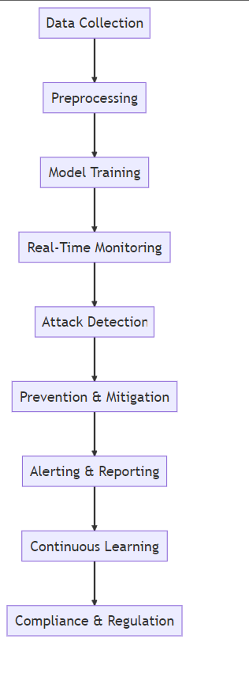
Work flow diagram
School of Computing
12

Slide 16
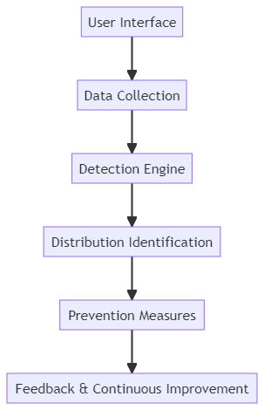
BLOCK DIAGRAM

Slide 17
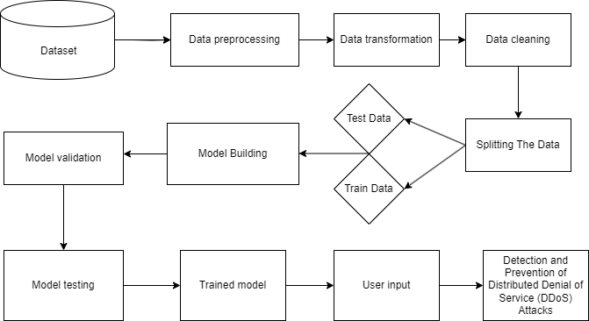
Architecture

Slide 18
Project Module Description
Module 1: Data Collection and Preprocessing
In the first module, the focus is on data collection and preprocessing. Researchers gather network traffic data from various sources and preprocess it to create a clean and structured dataset. This involves data cleaning, normalization, and the extraction of relevant features that can be used for DDoS attack detection.
Module 2: Machine Learning-Based Detection
The second module centers on the application of machine learning techniques for DDoS attack detection. Researchers develop and train machine learning models using the preprocessed data. These models are designed to identify patterns and anomalies in the network traffic that may indicate DDoS attacks. The module also involves continuous monitoring of network traffic and the use of trained models to detect potential attacks in real-time.

Slide 19
Project module description
Module 3: Mitigation and Response
The final module emphasizes mitigation and response strategies. In the event of a detected DDoS attack, researchers implement automated mitigation techniques, such as traffic filtering or redirection, to protect the targeted network or online service. Additionally, this module includes mechanisms for generating alerts and notifications to inform system administrators or security teams about the ongoing attack. The goal is to ensure swift and effective responses to mitigate the impact of DDoS attacks and maintain the availability of critical services.

Slide 20
METHODOLOGY
Data Collection: Gather network traffic data, including packet attributes and flow characteristics.
Feature Extraction: Transform raw data into relevant features, such as traffic volume, packet rates, and protocol types.
Model Training: Employ ML algorithms to build predictive models for normal and attack traffic patterns.
Real-time Analysis: Monitor incoming traffic, classify patterns using trained models, and trigger countermeasures upon attack detection.
ALGORITHMS:
Random Forest
Logistic Regression
KNN
SVC

Slide 21
METHODOLOGY
Proposed System:
In the proposed system, advanced machine learning techniques are employed for DDoS attack detection and prevention. These techniques, such as anomaly detection and deep learning, can effectively identify subtle patterns indicative of attacks. By continuously learning from network traffic, the system can dynamically adjust its detection mechanisms, improving accuracy and reducing response time.

Slide 22
METHODOLOGY
ALGORITHM:
Random forest: Random Forest is an ensemble learning method employing decision trees to predict outcomes. It operates by constructing multiple trees during training, using a subset of data and features randomly sampled. Each tree in the forest makes its prediction, and the final result aggregates these predictions, often via averaging for regression or voting for classification. This technique diminishes overfitting by combining various weak learners to form a robust model, effective for handling large datasets and maintaining accuracy. Its ability to handle missing values, maintain interpretability, and provide feature importance makes Random Forest a popular choice across diverse fields like finance, healthcare, and more.
Logistic regression: Logistic regression is a statistical technique commonly employed in binary classification tasks, which are prevalent in scenarios where the outcome variable has two possible categories, such as 0 and 1. In the context of your project focusing on the detection and prevention of Distributed Denial of Service (DDoS) attacks using machine learning methods, logistic regression serves several crucial roles. Firstly, it functions as a binary classifier,.

Slide 23
METHODOLOGY
distinguishing between normal network traffic and instances indicative of a DDoS attack. By training the logistic regression model on labeled datasets, it learns to predict whether incoming network traffic is benign or malicious, enabling rapid identification and response to potential threats.
K-Nearest Neighbors (KNN) : K-Nearest Neighbors (KNN) is a machine learning algorithm used for classification and regression tasks. It works by identifying the k nearest data points to a new observation in the training dataset and assigning a label based on the majority class among these neighbors. In your project on detecting and preventing Distributed Denial of Service (DDoS) attacks using machine learning, KNN can be used to classify network traffic as normal or part of a DDoS attack. It identifies patterns in network data and predicts whether new instances belong to a particular class based on similarities with existing data points. Additionally, KNN can help detect anomalies in network behavior, flagging instances that deviate significantly from the norm as potential threats. Despite its simplicity, KNN requires careful consideration of parameters such as the number of neighbors (k) and the choice of distance metric. However, it offers a straightforward approach to analyzing network data and identifying potential security threats

Slide 24
METHODOLOGY
Support Vector classifier (SVC):Support vector machine is a supervised machine learning algorithm used for classification tasks. It works by finding the hyperplane that best separates different classes in the feature space, aiming to maximize the margin between classes. on detecting and preventing Distributed Denial of Service (DDoS) attacks using machine learning, SVM can classify network traffic as normal or part of a DDoS attack. By identifying the optimal hyperplane based on extracted features, SVM distinguishes between different types of network activity. Additionally, SVM can detect anomalies in network behavior, flagging instances that fall outside the margin as potential threats.

Slide 25
Description of Software for Implementation
Hardware specifications:
• Microsoft Server enabled computers, preferably workstations
• Higher RAM, of about 4GB or above
• Processor of frequency 1.5GHz or above
Software specifications:
• Python 3.6 and higher
• Visual studio code

Slide 26
RESULTS AND DISCUSSIONS
The study results indicate that effective detection and prevention mechanisms are crucial in curbing the distribution of harmful content.
Various techniques, including machine learning algorithms and natural language processing, have been employed to detect and filter out such content.
The discussion highlights the importance of continuous monitoring and improvement of these algorithms to adapt to evolving distribution patterns.
The study emphasizes the need for effective reporting and flagging mechanisms to enable quick response and enforcement.
Overall, this research underscores the significance of comprehensive strategies that encompass both technological advancements and collaborative efforts to address distribution challenges and ensure a safer digital environment.

Slide 27
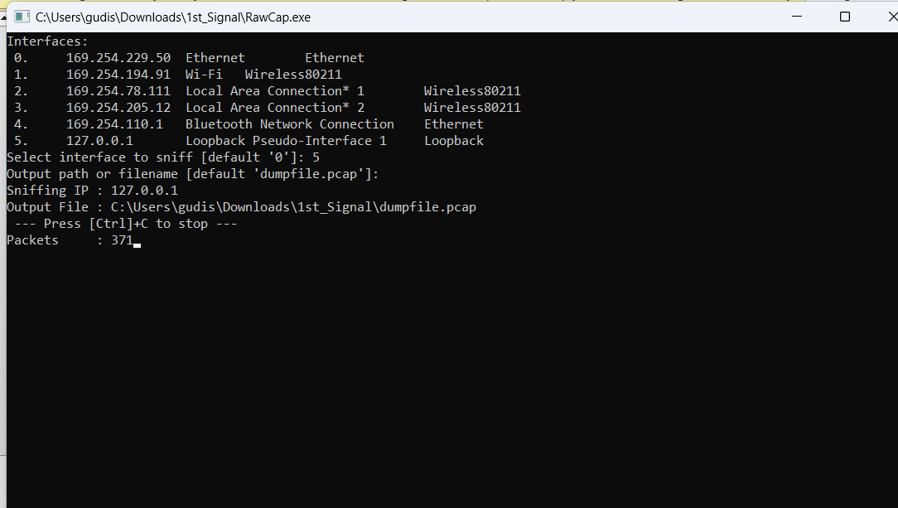
Result Screenshots
User interfaces:

Slide 28
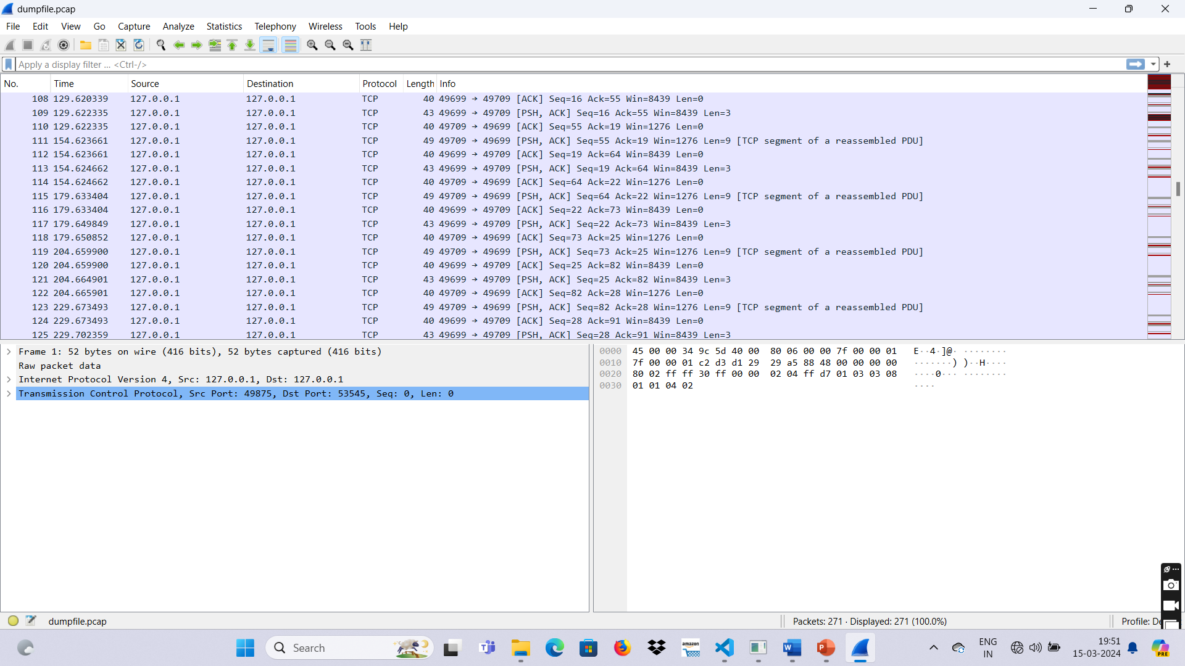
Final outcomes
Normal traffic:

Slide 29
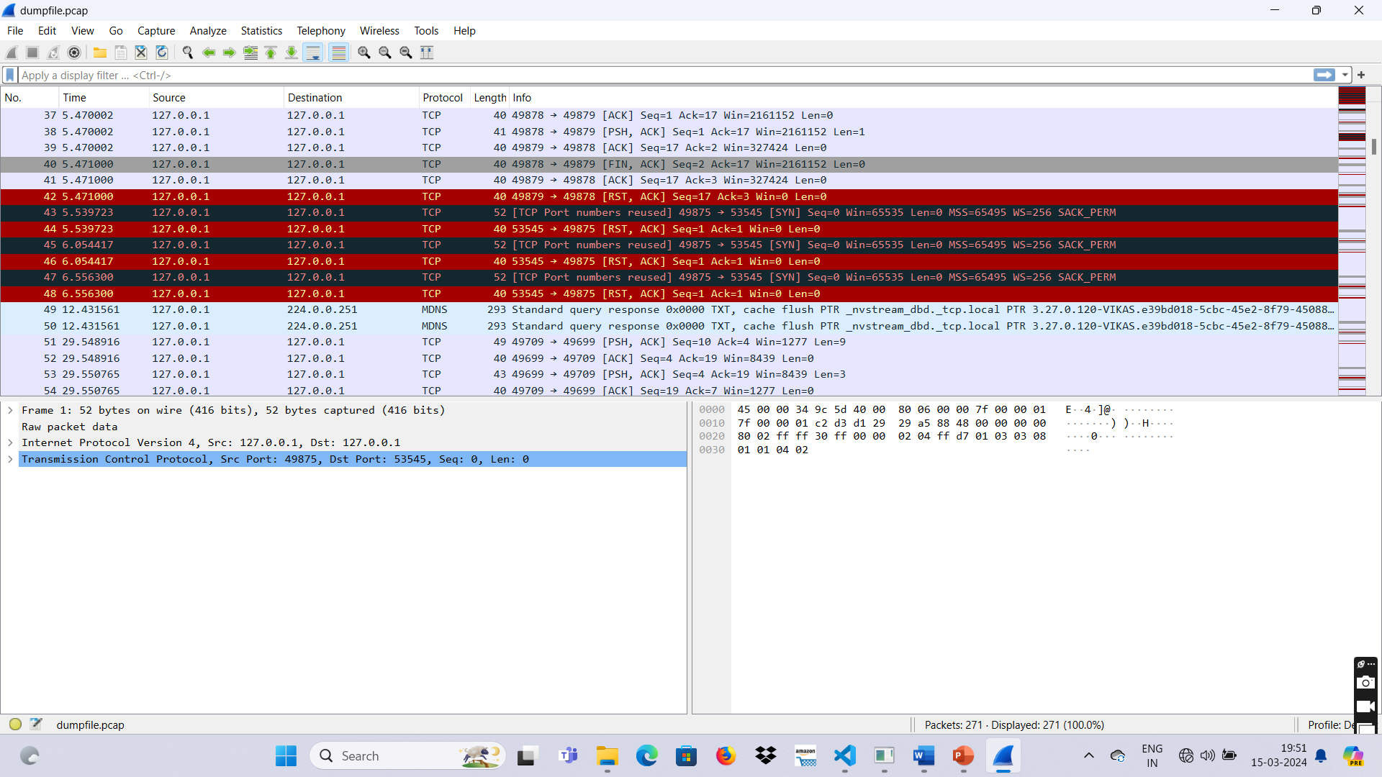
Final outcome
Attacked and normal traffic:

Slide 30
CONCLUSION
In conclusion, the detection and prevention of distribution holds significant importance in today's rapidly evolving technological landscape.
Businesses and individuals alike must remain vigilant in their efforts to identify and thwart distribution attempts of illegal or harmful content.
Advanced technologies such as artificial intelligence and machine learning can be utilized to analyze large volumes of data and identify potential threats.
Implementing robust security measures, such as encryption and multi-factor authentication, can help prevent unauthorized distribution Additionally, fostering a culture of cybersecurity awareness through employee training and education is crucial.
By remaining proactive and employing a multi-faceted approach, we can mitigate the risks associated with distribution and protect ourselves, our businesses, and our online communities.

Slide 31
FUTURE ENHANCEMENTS
In the future, advancements in detection and prevention of distribution will rely heavily on advanced technologies such as artificial intelligence and machine learning.
AI algorithms will be trained to analyze vast amounts of data from various sources, including social media platforms and dark web marketplaces, to identify patterns and detect potential instances of distribution.
Furthermore, the integration of machine learning models with real-time monitoring systems will enable predictive analytics, allowing authorities to preemptively target potential distribution channels.
Ultimately, these enhancements will greatly enhance the efficiency and effectiveness of detection and prevention efforts, making the world a safer place for all.

Slide 32
REFERENCES
Zekri M, Kafhali S, Aboutabit N, Saadi Y, “DDoS attack detection using machine learning techniques in cloud com- puting environments”, 3rd international conference of cloud computing technologies and applications (CloudTech), pp 1–7,2017.
Kably, S., Benbarrad, T., Alaoui, N., & Arioua, M. (2023). Multi-Zone-Wise ML Based Intrusion Detection and Prevention System for IoT Environment. Computers, Materials & Continua, 75(1).
Idhammad M, Karim A, Belouch M. Semi-supervised machine learning approach for DDoS detection”. Appl Intell.2018.
S Das, Ahmed M. Mahfouz, D Venugopal, S Shiva, “DDoS Intrusion Detection Through Machine Learning Ensemble”,IEEE 19th International Conference on Software Quality, Reliability and Security Companion (QRS-C), 2019.INSPEC
M. Alkasassbeh, G. Al-Naymat et.al,” Detecting Distributed Denial of Service Attacks Using Data Mining Technique,” (IJACSA) International Journal of Advanced Computer Science and Applications, Vol. 7, pp.436-445, 2016. Science and Information Technologies, Vol. 6 (2), pp.
1096-1099, 2015.

Slide 33

CONFERENCE CERTIFICATE

Slide 34

CONFERENCE CERTIFICATE

Slide 35
THANK YOU
We Thank Our Guide, Panel And All
Technical And Non Technical Staff
Helped Us In Achieving this.

